Slide 1
A Survey on Tracking Methods for a Wireless Sensor Network
Taylor Flagg, Beau Hollis & Francisco J. Garcia-Ascanio

Slide 2
Overview
Sensor Network Tracking
  Hierarchical Approach
  Hidden Markov Model with Binary Sensors
  Compare and Contrast
Pursuit Evasion Games
  Two-Tier Approach
  Multi-Hop Approach
  Ant-Based Approach
  Compare and Contrast
Conclusion

Slide 3
Sensor Network Tracking
Tracking an object moving through a field of sensors
  Smart House
  Air Traffic Control
  Fleet Monitoring
  Security
Many sensor types can be used

Slide 4
Hierarchical Approach
STUN: Scalable Tracking Using Networked sensors
  Sensor network described as a hierarchical graph
  Each node has a detection set
  Object positions are queried from the root using detection sets

Slide 5
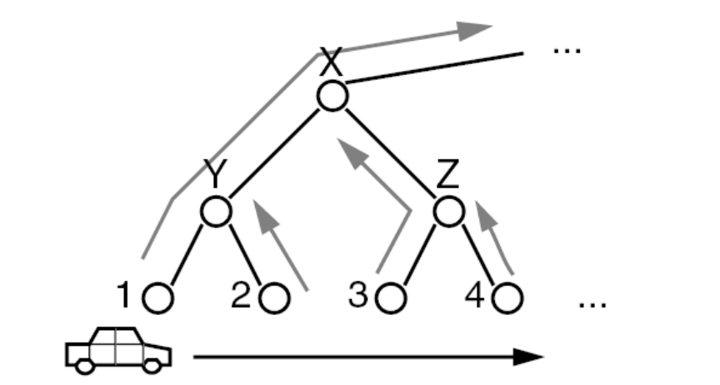
Detection Sets
Nodes broadcast detected objects
Parents broadcast set of objects detected by their child nodes
Only broadcast when set changes
Redundant massages are pruned

Slide 6
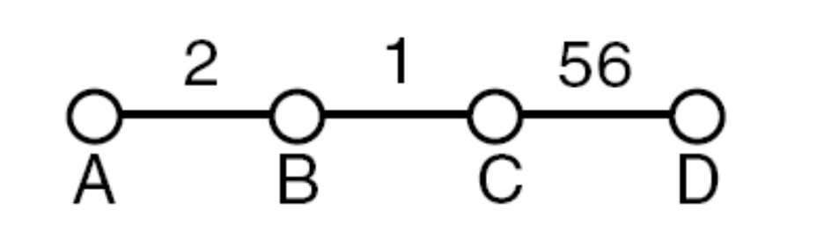
Graph weights
The sensor graph is weighted based on movement patterns
Higher weight means more objects transition between those two nodes

Slide 7
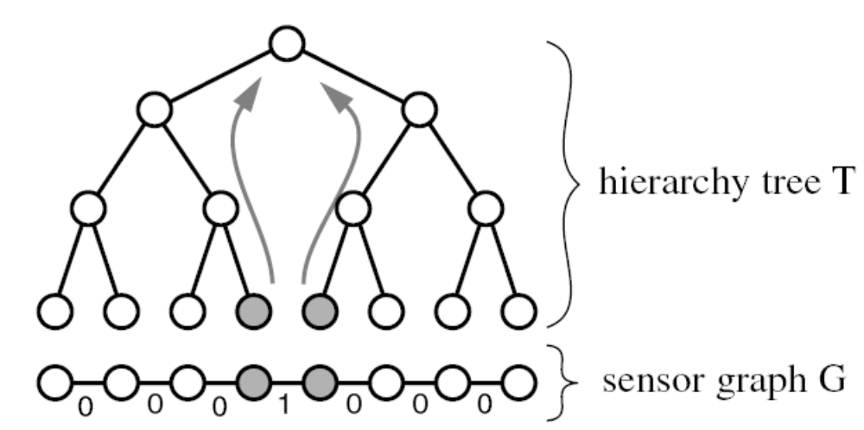
Communication Cost
Depends on number of messages transmitted
Tree structure affect cost

Slide 8
DAB – Drain and Balance
Idea
  Imagine flooding a mountain range
  At each step water level is lowered and visible peaks are added to the tree
Actual Algorithm
  Set a weight threshold
  Add balanced sets of with weights above the threshold
  Iteratively lower threshold and reapply

Slide 9
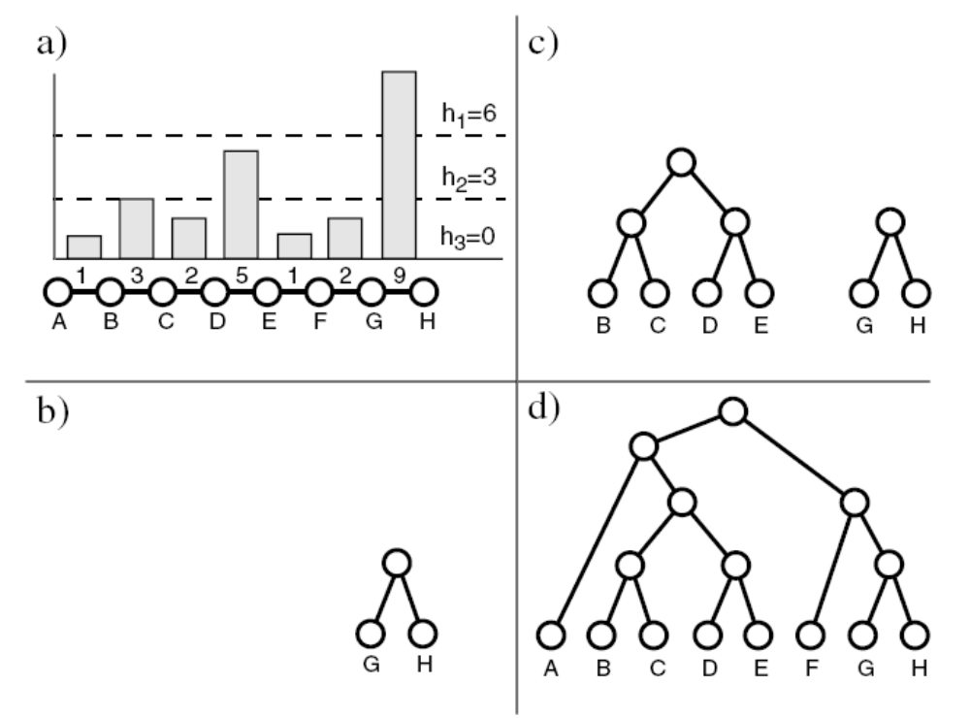
Drain and Balance Example

Slide 10
Using Hidden Markov Model to Track with Binary Sensors
Binary sensors only report if an object is detected or not
Reduces affect of calibration and error
Sensor location is not needed
Object paths are based on statistical analysis

Slide 11
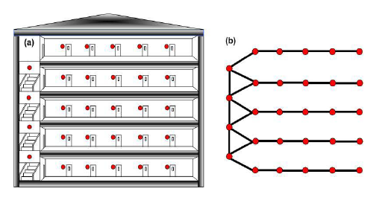
Graph
Sensor graph with links for adjacent sensors
Graph forms Hidden Markov Model (HMM)
HMM is used to calculate probable object paths
Path prediction uses the Viterbi Algorithm

Slide 12
Implementation
Each node stores 3 values required for the path calculation
  Probability of an object starting at that node
  Probability that objects will be accurate detected (accounts for sensor error)
  Matrix of probabilities for transition to another node in the node’s neighborhood

Slide 13
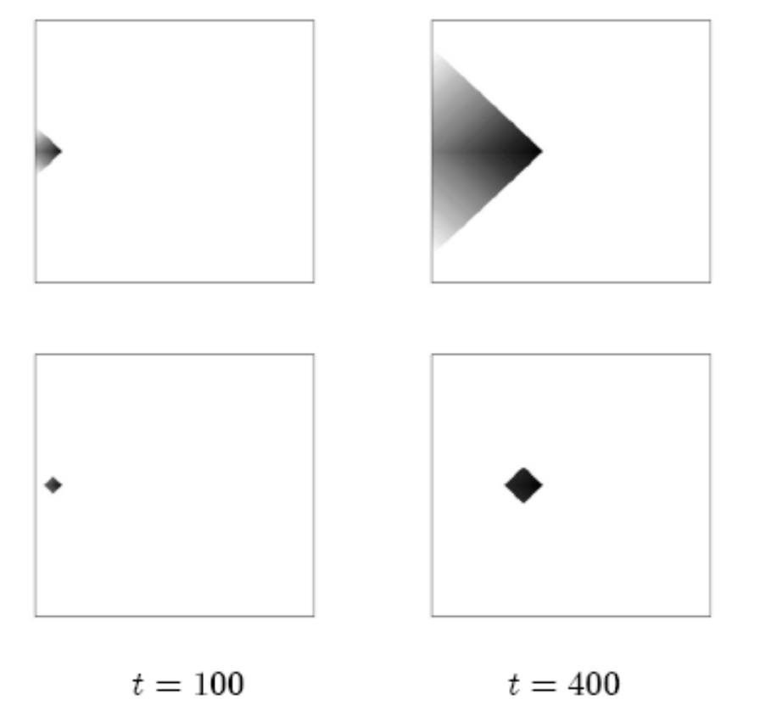
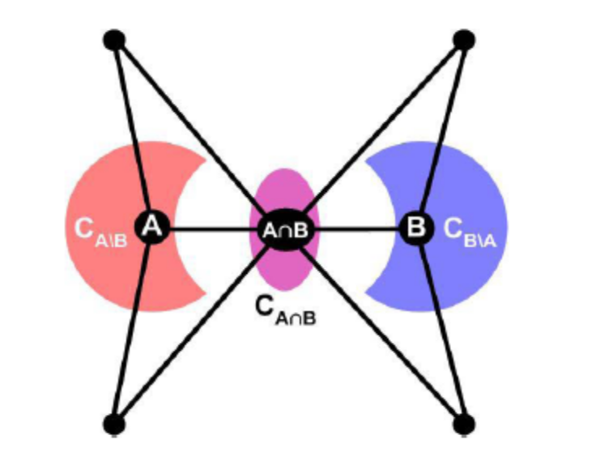
Pruning and Overlap

Slide 14
Similarities
Avoid localization issues by graphing sensor topology
Communicate in between nodes rather than flooding the network
Pruning redundant information
Use pre-computed probabilities and weights to gain efficiency

Slide 15
Differences
HMM
  Operates on binary sensors
  Processes all necessary information in each individual node, distributes tracking
  Communicates back and forth among neighbors
STUN
  Made for non-uniform movement
  Leaves actual tracking to a centralized query-point
  Only communicates up hierarchy tree

Slide 16
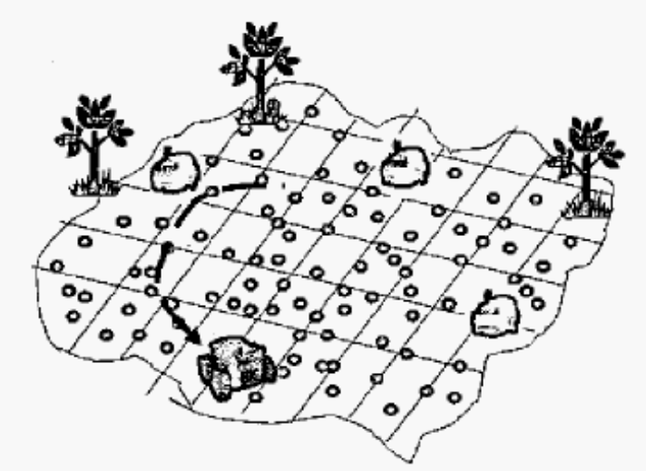
Pursuit Evasion Games
Autonomous agents (Pursuers) pursue one or more non-cooperative agents (evaders)
Sensor networks are used to detect evaders

Slide 17
Pursuit Evasion Games
In traditional PEG’s
  The evaders attempt to avoid detection and capture by varying speed and direction
Different forms of PEG’s consist of
  Rescue operations
  Surveillance
  Localization and tracking of moving parts in a warehouse, etc.

Slide 18
Two-Tier Approach
Lower Tier
  Numerous nodes
  Handles simple detection
  Limited resources
  Provide basic information
  Power conservation
  Results gathered don’t need to be perfect
  Leader election algorithm based on strongest detection

Slide 19
Two-Tier Approach
Higher Tier
  Fewer nodes
  Nodes are more complex (e.g. sophisticated camera nodes.)
  Handles processing and initiates actions
  Resulting actions sent to the pursuer

Slide 20
Pursuer in Two Tier System
Pursuer has its own onboard software service for interception and navigation
  Receives detection events from the network
  Determines if event was caused by the evader, another pursuer, or noise
  Pursuer only needs data from the network every few seconds
  Uses GPS to calculate an interception destination

Slide 21
Multi-Hop Approach
Sensor nodes estimate evader positions and push their data to other nodes and to the pursuer
Super nodes
  Receive data and do processing to get a composite estimate
  Collaborate with neighbors to further improve the estimates
  Broadcast final estimate to pursuer

Slide 22
Multi-Hop Problems
Cost effective sensors are problematic
  Small power supply
  Low detection probability
  High false alarm rate
With each hop, likelihood of transmission failure and packet delays increase

Slide 23
Ant-Based Approach
Based on how ants gather food
  Ants leave trail of pheromones
  Other ants follow the direction in which pheromones are most intense
Sensors store a timestamp of evader detection
Pursuer looks compares timestamps in a region to derive the evaders direction

Slide 24
Ant-Based Implementation
Ant-Based approach is broken down into three phases:
  Reporting the Initial Position
  Initiation of Tracking
  Tracking

Slide 25
Reporting the Initial Position
Starts when first sensor detects evader. This node will do the following
  Contacts pursuer
  Broadcast to entire network about the evader and suppresses other nodes from contacting the purser with redundant information
Subsequent nodes will send new information to the purser but not the entire network

Slide 26
Initiation of Tracking
Pursuer heads toward the first node to detect the evader
Pursuer queries nearby nodes for timestamps
These timestamps are used to determine the velocity vector

Slide 27
Tracking
Pursuer intelligently queries only nodes in the direction of the velocity vector
Compares timestamps and looks for larger timestamp value
Cuts down on communication costs
The velocity vector is updated and the process is repeated until the evader is captured or leaves the network

Slide 28
Similarities
Sensor nodes are pre-established in the region that the evader will occupy
Systems provide a lower tier of nodes that only collect evader data

Slide 29
Differences
Two-Tier
Higher tier contain processing and tracking algorithms
Dedicated software services located on the pursuer
Elect a leader node to distribute information
Results don’t need to be perfect
Leader election based on strongest detection
Multi-Hop
Higher tier nodes contain processing and tracking algorithms
Collaborates with neighboring super nodes to improve estimates
Super node similar to leader election to propagate information to pursuer
Ant-Based
Nodes collect timestamp of evader
Pursuer uses timestamp to get velocity vector and which node to contact next
Nodes communicate only with pursuer

Slide 30
Conclusions
The tiers systems can benefit from hierarchal topology
  Super nodes are at the root of the tree
Ant based approach
  Use HMM to shift processing from the pursuer to sensor network
  Pursuers queries the sensors

